Slide 1
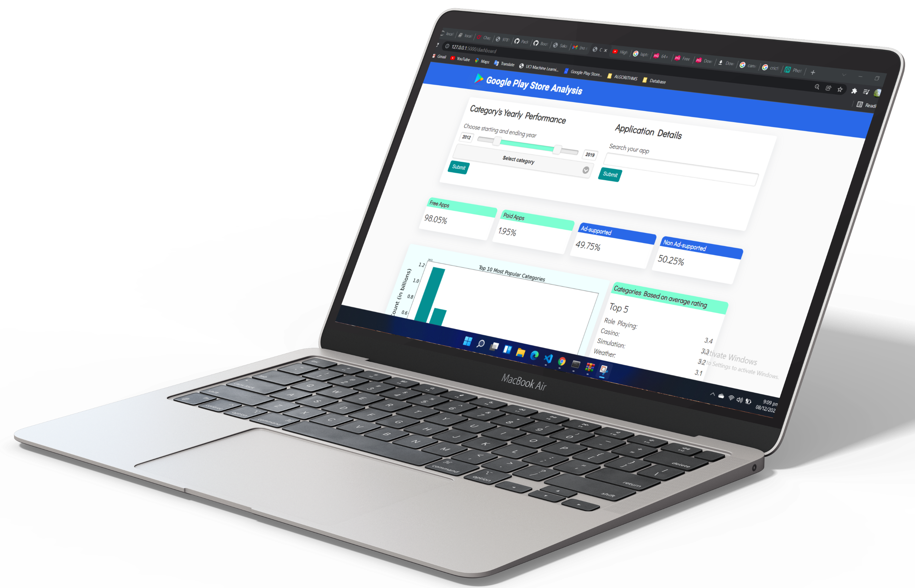
GOOGLE PLAY STORE ANALYSIS
WEB-BASED DASHBOARD USING PYTHON
FLASK LIBRARY
Presented by:
Fareed Hassan Khan - 25367
Syed Asad Rizvi - 25365

Slide 2
PRESENTATION FLOW
Project Summary
Dataset
Languages & Libraries
Bootstrap & CSS
Goals Achieved
Features
Website Navigation Flow

Slide 3
PROJECT SUMMARY
Analysis of 2.3 million+ Google Play Store applications.
Helpful for developers to create potential web-based applications.
Conducted detailed analysis using graphs & visualizations.
Cherry-topped with user-friendly features.

Slide 4
DATASET
Scraped data of 2.3 million+ Google Play Store applications of different categories.
Imported from www.kaggle.com (.csv file used)
Updated 03 times in a year. Currently ranging from 2010 to Jun 2021
Contains parameters such as Category, Rating, Size, Installs Count, Release date, and much more.

Slide 5
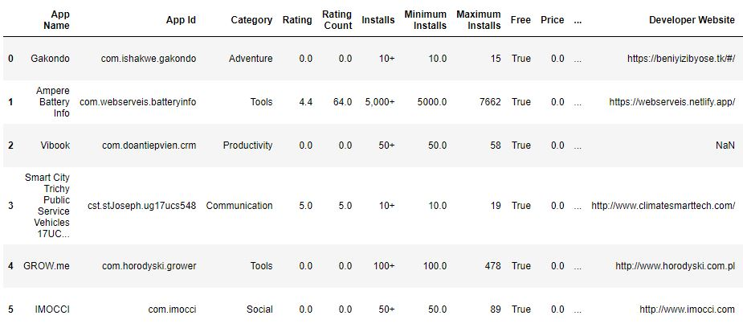
Google Play Store Dataset
A Brief Look

Slide 6
LANGUAGES & LIBRARIES
Python
Flask
Pandas
NumPy
Matplotlib
HTML, CSS & Bootstrap
JavaScript

Slide 7
BOOTSTRAP & CSS
Layout of our project.
Styling of our web app.
Slider to choose starting and ending years in a feature.
Feature of zoom-in on image hover.

Slide 8
GOALS ACHIEVED
Percentage of Free & Paid Apps
Percentage of Ad-free & Ad-supported Apps
Percentage of Secured & Non-secured Apps
Applications released per year
User Count per year
Cheapest & Most Expensive Apps
Most Popular Applications & Categories
and much more….

Slide 9
FEATURES
Sliders to check average rating of a category for each year.
Search bar for users to find out details of an application.
Feature to check the minimum compatible Android version of the applications.

Slide 10
WEBSITE NAVIGATION FLOW
Feature 1
Form
On Submit
Feature 1
Result
Index Page
Dashboard Page
with or w/o features results
Feature 2
Form
On Submit
Feature 2
Result

